Slide 1
Lab 5 - Path Planning
Lab TAs: Omar Aldhaher, Kenji Tella and Varun Sureka

Slide 2
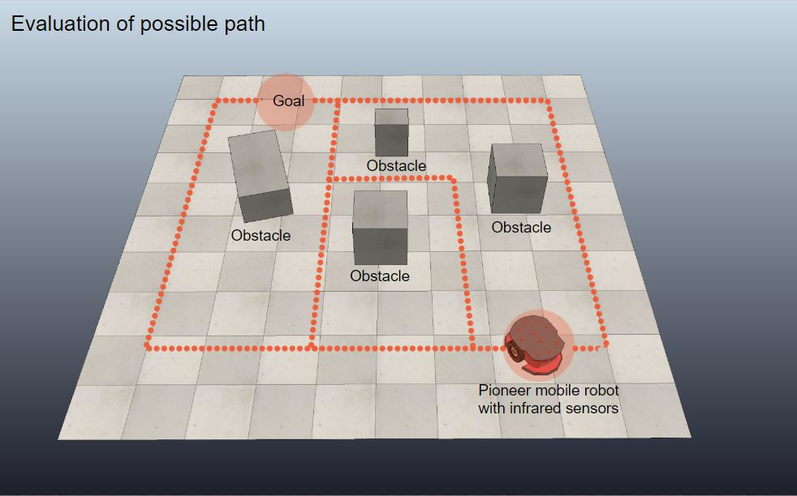
Goal
Given a start pose and end pose, plan and execute a path through a known map without touching any obstacles
picture from https://www.iaacblog.com/programs/path-planning/

Slide 3
Demo Procedure
Choose a reference point on your robot (all measurements will be made with respect to that point).
You will be given a start position (x1, y1) and end position (x2, y2). They will be at least 5 in from all obstacles (including the walls). These coordinates will be with respect to a bottom-left origin.
  E.g. “You starting position is (40, 32) and goal is (16, 8)”
Your robot will initially be oriented in one of the four cardinal directions. (Picked randomly during demo!)

Slide 4
Demo Procedure
4. Run your path planning algorithm to determine the path to be taken by the robot. You must show this path to the TA before the robot moves.
This does NOT have to be done on the MotorGo Plinks. You may use Python, MATLAB or any other tools to generate your trajectory.
5. Your robot will navigate from the given starting position to the given ending position within specified time limits.
You will be graded on the L2 error between the goal position and the reference point on your robot, and the time taken to get there.

Slide 5
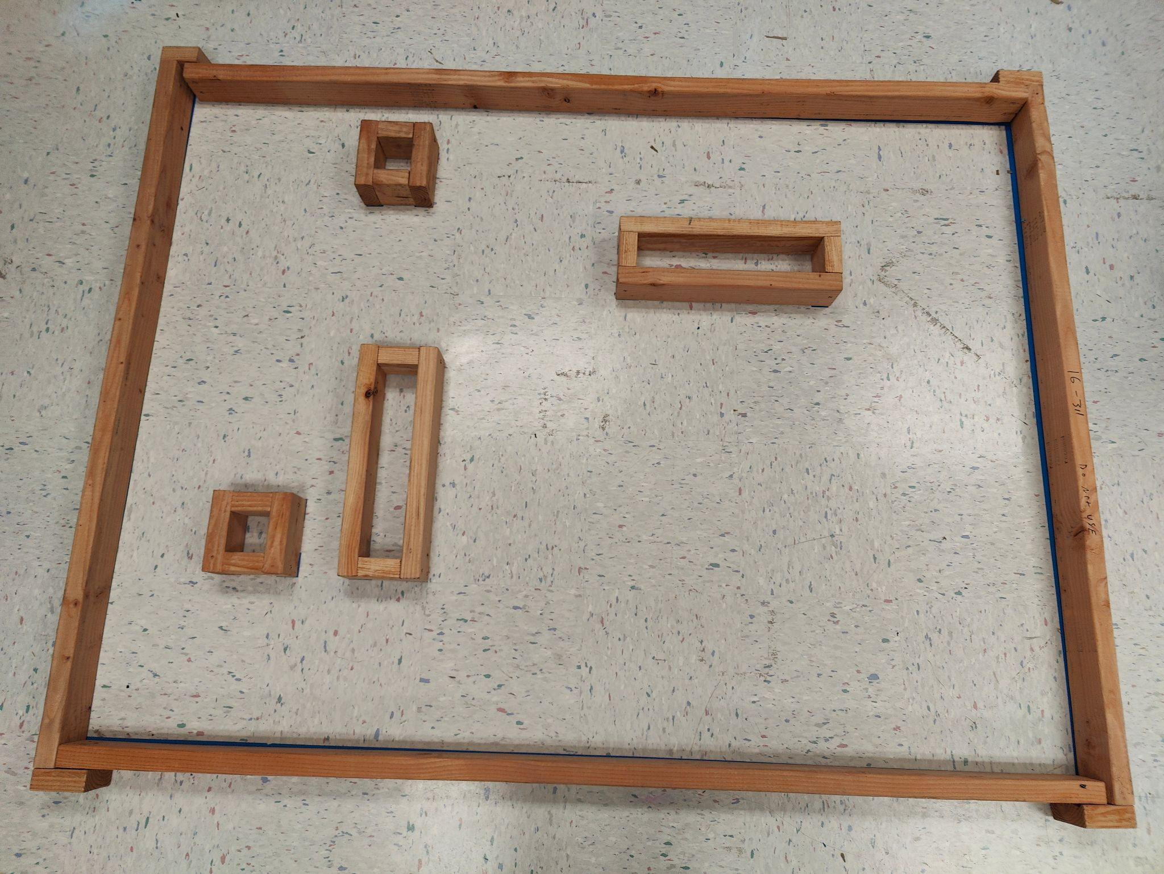
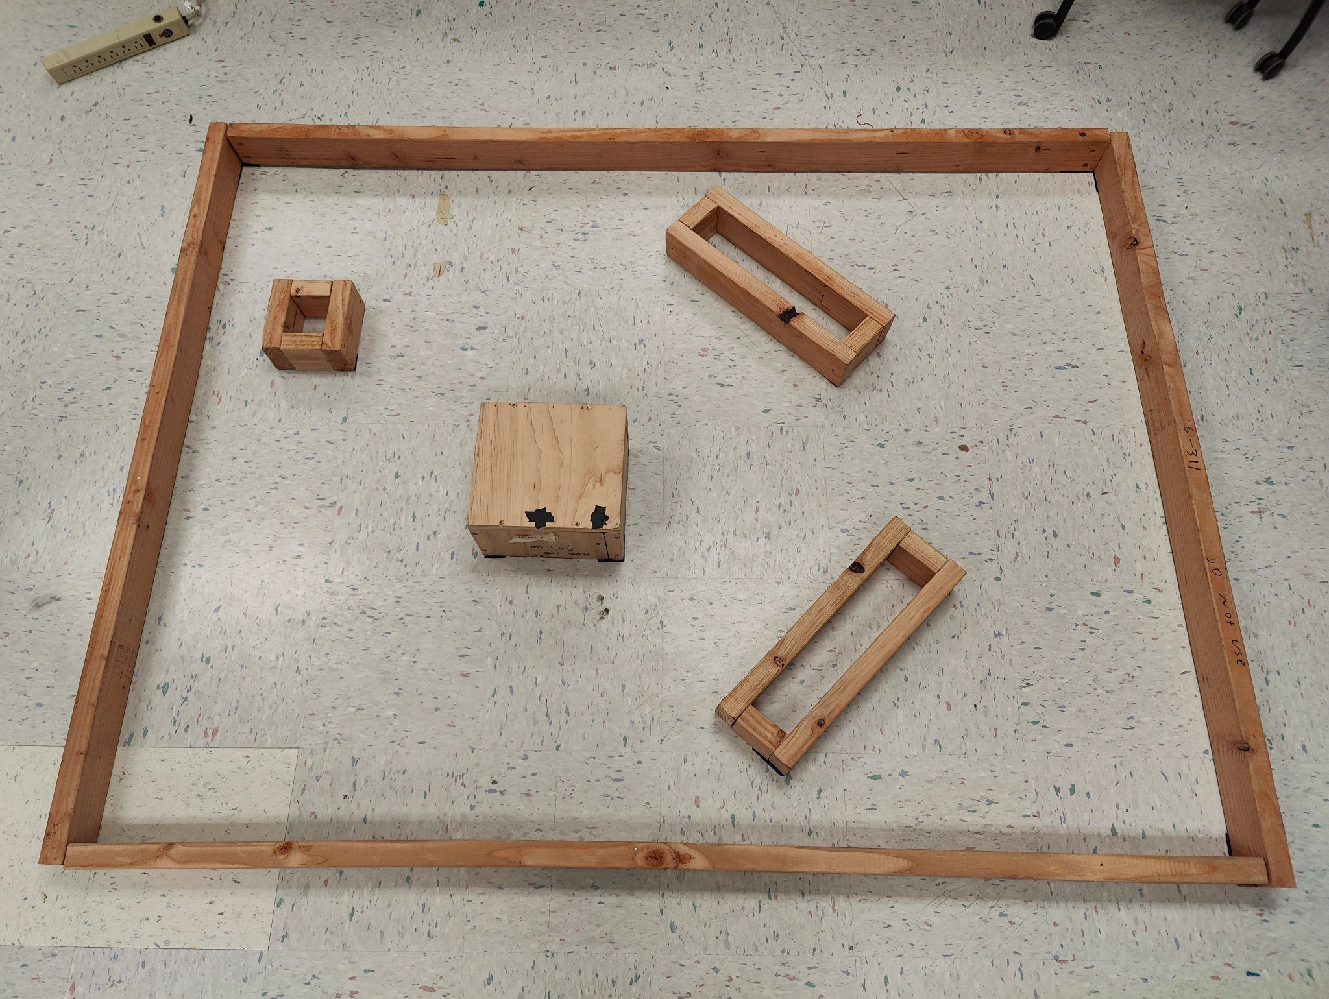
The Courses
OPTION: Run without physical obstacles (-20 points)
The obstacles will still be there, but only as tape marks. If your robot does not clearly attempt to navigate around the tape lines, YOU WILL GET A 0.
(This allows you to demo without fear of hitting the obstacle and having odom mess up beyond recovery)
Easy Course
Hard Course
Insert picture of easy course here
Insert picture of hard course here

Slide 6
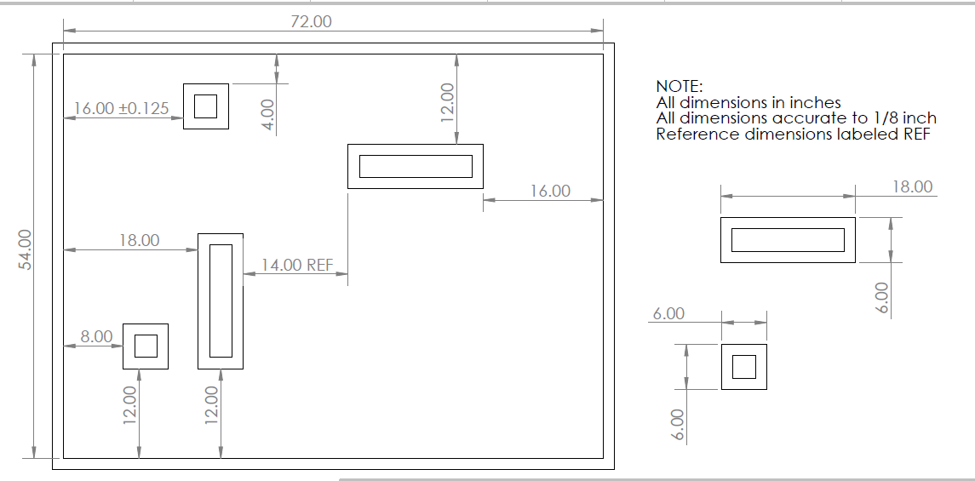
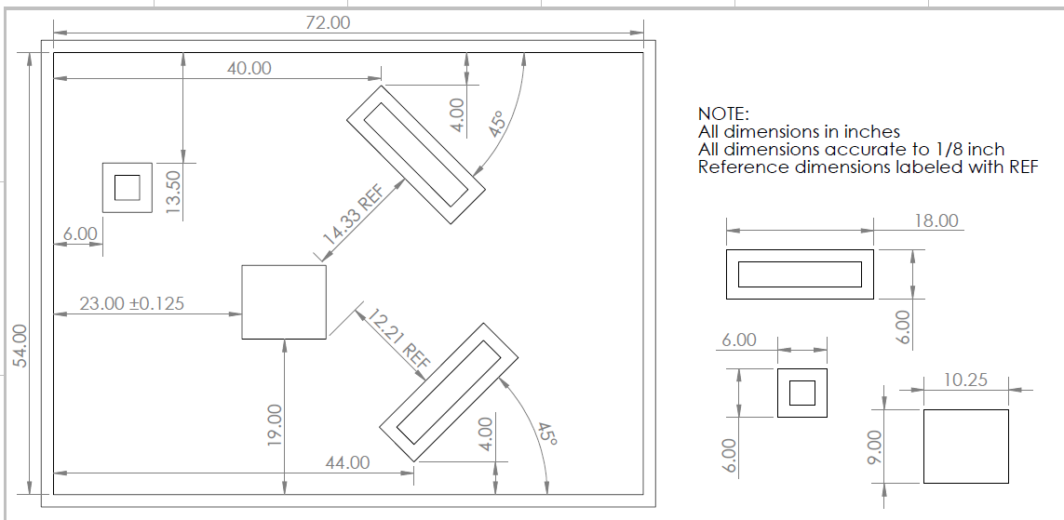
Obstacle Locations (inches)
Coordinates for path planning are given in (x, y) form
Origin is at bottom-left corner of each course
Positive-x is towards the right
Positive-y is towards the top
Your robot’s initial orientation will be a random cardinal direction picked by the TA (you can input it into the code)
All coordinates are in inches and are approximate. You are responsible for measuring their locations yourselves to be sure.

Slide 7
Tasks
We will provide some helpful materials you should take advantage of:
  construct_map.py (to help you port maps into your code)
  Psuedo code for path generation methods
  Pseudo code for roadmap path planning strategy
Prepare your odometry as necessary so that it can interface with the rest of the code you will write.
Think about your map representation (grid, voronoi, visibility, etc). Which one will you choose? How will you represent it?
  Remember to incorporate your c-space into your map representation.
  For better code modularity, we recommend creating a separate file for map representation helper functions.

Slide 8
Tasks
Write your path planning algorithm. This does not need to be done in the same file as your motor commands.
  You can write this in any language you choose. (although if you want to use the starter construct_map.py, it’ll probably be python)
  You cannot use any built-in graph search functions or packages that trivialize this (ask on Piazza).
Choose any algorithm you want! (ask: optimal with respect to what?)
  Bug 1 / Bug 2
  Wavefront
  Potential function
  Djikstra/A*
  Anything else!
Note: During demos, you will need to show the TA the path before your robot moves.

Slide 9
Tasks
Write your path following code. Convert the path above to motor commands. Here are some options to consider.
  Blind point-and-drive (Is this a good idea?)
  Some combination of PID on heading error and/or lateral error from the path
  Pure pursuit
  Anything else!
Choose one that works best for your team.

Slide 10
Displaying Your Path
You must show TAs the intended path/trajectory before your robot moves
  Your path must be easily understandable for TAs during the demo
  Ex: If you used waypoints, you can bring a hard copy of a map with waypoints marked on it.
    Showing the TAs a list of points that the robot will follow is a valid way of showing an intended path
  You could generate a map with the clearly identifiable path displayed on it using tools like Matlab or Python
    If you choose Matlab in conjunction with BrickPi, please be sure to practice interfacing between Matlab and BrickPi by demo day (given very limited demo time)
Time taken to calculate path will be part of your 7 minute demo slot.
  You will need to calculate and show the path for each of the two trials.

Slide 11
Individual Q & A
At the end of your team’s demo, we will ask each member of your group one question (3 total questions) that can be related to any of the following:
General path planning algorithms
Your team’s implementation for the lab
The trade-offs your team made when implementing your algorithm
Real-world path planning
MAKE SURE you fully understand every aspect of your team’s implementation before the demo.
You will NOT be allowed to consult with your teammates when we ask you a question.

Slide 12
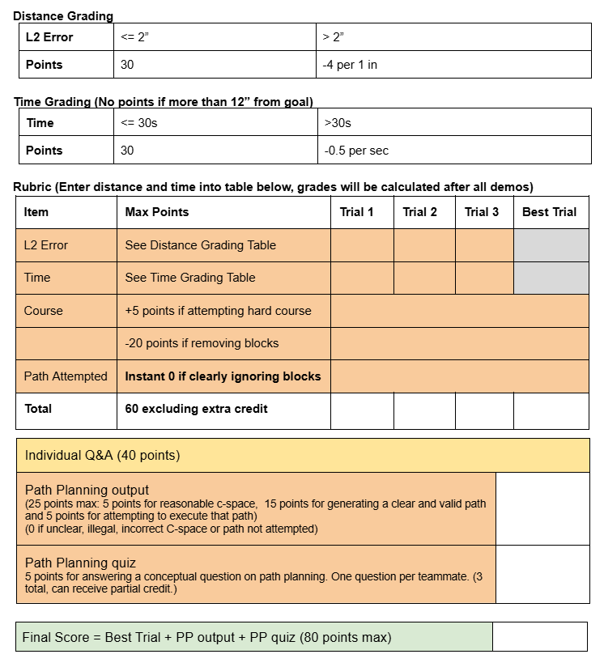
Grading
Link to Rubric here.
*You have 3 TRIALS in total, but both have to be on the same course.
Attempts on the hard course get 5 free points, and this CAN get you extra credit. (capped at 100)

Slide 13
Key Specifications
The robot can be no larger than 1 ft x 1ft x 1ft, but a smaller robot may be better.
Teams can decide the reference point on the robot for calculating the L2 error (must be consistent during the demo).
The start position (x1, y1) and end position (x2, y2) will be at least 5 in away from all obstacles, including the wall.
The robot will be initially oriented in a random cardinal direction.
The map’s origin is at the bottom left corner of the course.
The border is 6 feet by 4 feet 6 inches. (72” x 54”)
All coordinates are in inches and within ⅛”.

Slide 14
Key Regulations
The obstacles are assumed to be infinitely tall
  No part of your robot can hover over the top of the obstacles regardless of how tall they are in the real world.
Your demo stops when your robot stops
  Your L2 error will be calculated from the position of your robot at the time the trial was stopped.
  You may not prematurely stop your robot while it is completing its path
We will give you start/end points using the axes convention outlined earlier.
  If you are using a different convention, it is your responsibility to convert what we give you to what you actually need.

Slide 15
Key Regulations
You must bring your grading sheet to the demo. Teams without grading sheets will not be allowed to demo.
You are NOT allowed to use any sensors.
There is a MANDATORY video demo submission which can count up to 50% of your final lab grade if your in person grade falls below 50%.
You are NOT allowed to use library functions to plan any part of your path (data structures like priority queues and such are allowed).

Slide 16
Additional Help
We will provide you with construct_map.py, which you can use to generate maps for your path generation algorithms
We will provide you with some pseudocode for A*, pseudocode for a wavefront planner, and pseudocode for a roadmap path planning strategy. However, as mentioned before, you are allowed to use any algorithm for path planning.
These files will be released by tomorrow morning

Slide 17
Tips
Choose your algorithm carefully
  Ease of implementation
  Quality of solution
  Reliability
Practice the demo procedure before your demo!
  Ensure that the path you calculated can be easily ported into your movement implementation
Be prepared to answer questions at the end of your demo
Hitting an obstacle will severely hurt your chances of successfully completing a path.
Your code from Lab 3 (Odometry) with PID incorporated into it will be useful for this lab.
Start early!
Consider what constitutes the optimal path
  “Optimal with respect to what?”
  Speed vs. Safety vs. Accuracy
Define a good C-Space before you start doing path planning
  This will be affected by your robot size. Build with this in mind.
  Be sure you know where is the origin of your C-space
Take time to tune your dead-reckoning properly
  Think about mechanical changes that can give you an advantage

Slide 18
Questions?

